Slide 1
MentalMate AI APP
AND-102 POD 4
Brian Bazurto, Christine Lekishon, Jocelyn Gao
Notes:
Welcome everyone. Today, I'm excited to introduce you to MentalMate, a revolutionary app designed to empower you with personalized insights and recommendations for managing your mental health.

Slide 2
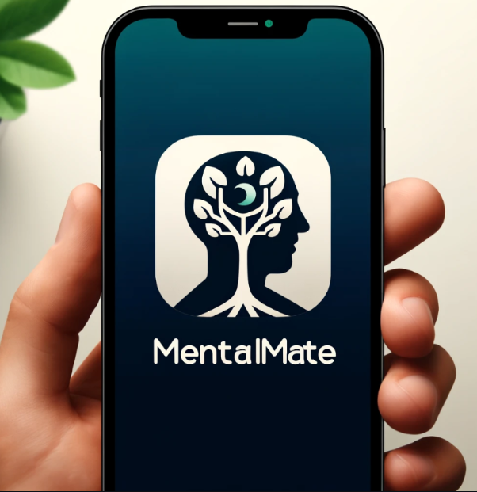
Overview
MentalMate offers customized insights and recommendations to empower you with a complete understanding of your mental health, aiding you in managing and improving your well-being.
Notes:
We're here to explore how MentalMate can help you gain a comprehensive understanding of your mental well-being, enabling proactive management and improvement of your mental health.

Slide 3
Table of contents
01
Story & Market
02
Features
03
APP UI
04
Demo
Notes:
In today's presentation, we will cover four main areas: First, we will delve into our story and the market need for MentalMate. Next, we will discuss the core features that make MentalMate a unique tool in mental health management. We will then take a close look at our user-friendly app interface. Finally, we'll conclude with a live demo to showcase how MentalMate works in real-time.

Slide 4
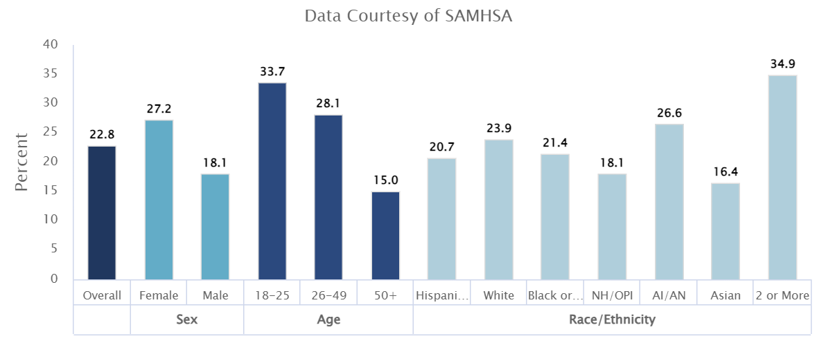
Prevalence of Any Mental Illness (AMI) - 2021!

Slide 5
Our story & Prevalence of Any Mental Illness
With 22.8% of U.S. adults, approximately 57.8 million, diagnosed with Any Mental Illness (AMI) in 2021, MentalMate addresses a critical and widespread need for accessible mental health support.
The prevalence of AMI was significantly higher among young adults and varies across gender and racial demographics, demonstrating the diverse and extensive market for personalized mental health services tailored to individual lifestyles and challenges.

Slide 6
01
Story & Market

Slide 7
Personalizing Mental Health Support
Story
Goal
Inspired by a recognized need for accessible, personalized mental health tools.
Founded on a commitment to mental health advocacy and leveraging technology for wellbeing
To provide AI-powered, tailored mental health support that evolves with user feedback.
Aims to improve mental health outcomes by integrating behavioral data and user interactions.
Notes:
At MentalMate, we believe in personalization as the key to effective mental health support. Our app delivers daily mental health tips that are customized based on each user's unique behavior and preferences. This personalized approach not only keeps our users engaged but also promotes sustained mental wellness through actionable insights and practical advice.

Slide 8
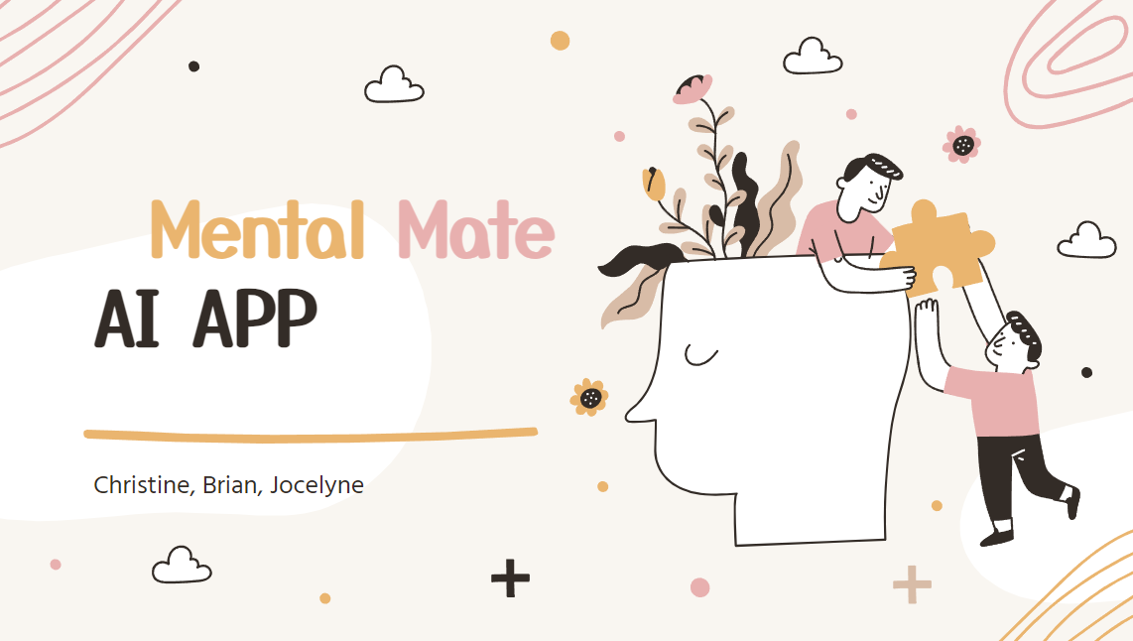
Habit and Scope
MentalMate delivers daily, customized mental health tips based on your unique behaviors and preferences. This tailored approach boosts engagement and supports sustained mental wellness.
Notes:
Personalized Insights and Tips:
MentalMate delivers daily mental health tips and actionable insights, meticulously customized based on each user's behavior, activity data, and stated preferences. This tailored approach helps maintain user engagement by providing relevant, practical advice and encourages consistent practice of mental health routines to foster long-term well-being and habit formation.

Slide 9
Personalizing Mental Health Support
Target Market
Potential User Base
Primarily aimed at individuals seeking tools for mental health improvement.
Suitable for a diverse demographic: students, professionals, and general wellness seekers.
Increasing social health acceptance of mental health discussions broadens the user base
Ideal for tech savvy individuals who value mental wellness and innovation

Slide 10
02
Features of the App

Slide 11
Features
Required Features:
User Login
User Profile
AI-driven Insights.
Optional Features:
Health Sensor Integration
Curated Resources
Emotional Intelligence Building
Support Network
Community Forums
Notifications
Notes:
MentalMate is equipped with a range of features designed to offer a comprehensive mental health support system. From secure user login and personalized profiles to AI-driven insights, MentalMate provides an all-encompassing solution. Additionally, our optional features like health sensor integration and emotional intelligence workshops enhance the user experience by offering more specialized support and community interaction.

Slide 12

AI FOR Mental Health

Slide 13
03
APP UI

Slide 14
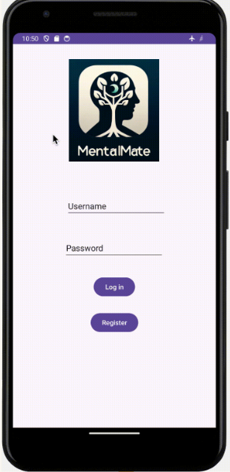
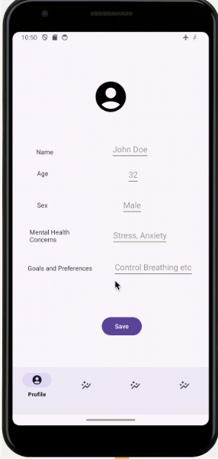
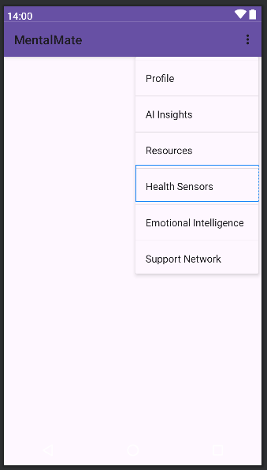
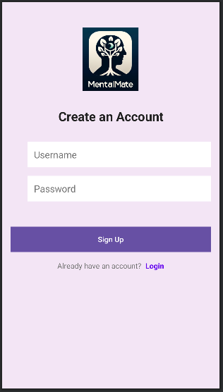
APP pages - MentalMate
Menu
Sign up
User Login
Profile
Notes:
Let's take a closer look at the MentalMate app interface. Our app is designed for ease of use with a simple, intuitive layout. Users can sign up, log in, and navigate through their personal profile and menu with ease. Our AI Insights Chatbot, Support Network, and extensive Resource Library are all just a few taps away, making mental health support both accessible and engaging

Slide 15
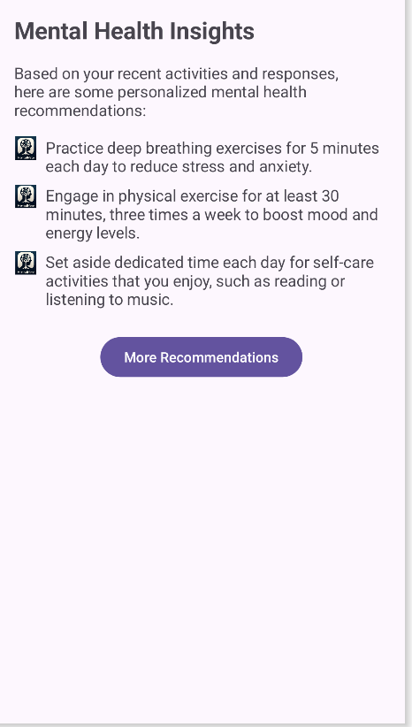
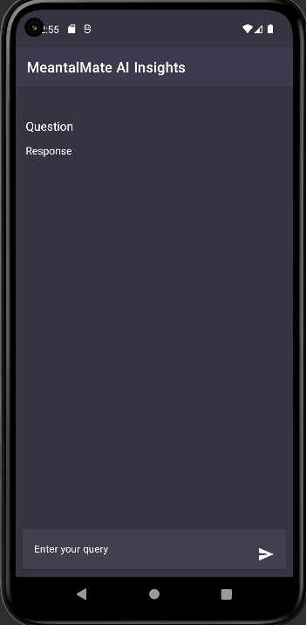
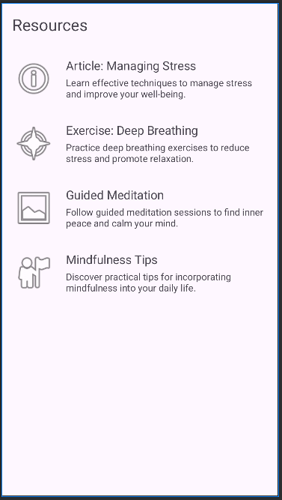
APP pages - MentalMate
AI Insights
AI Insights Chatbot
Resources

Slide 16
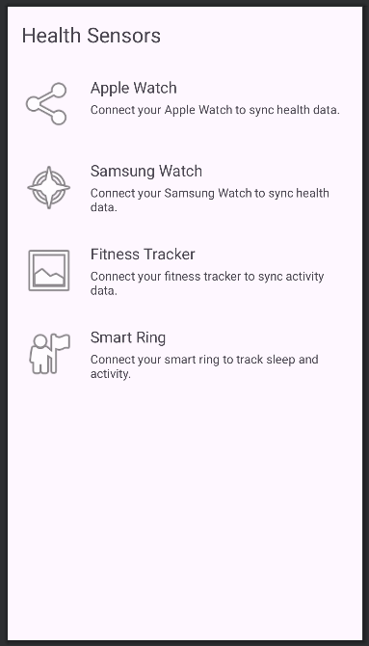
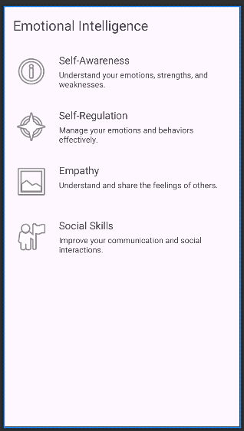
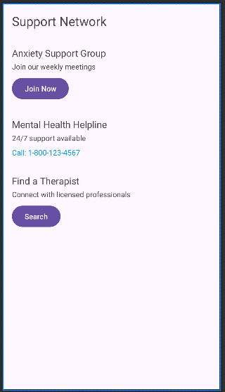
APP pages - MentalMate
Health Sensors
Emotional Intelligence
Support Network

Slide 17
04
DEMO

Slide 18
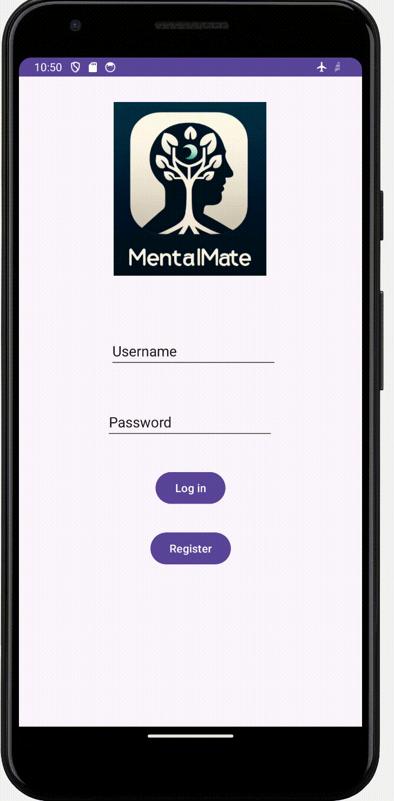
DEMO
Notes:
Now, let’s move into the most exciting part of our presentation—a live demonstration of MentalMate. I'll walk you through the core functionalities of our app, showing you exactly how each feature works and how it can be used to manage and improve your mental health in real life scenarios.

Slide 19
Thanks!
Notes:
Thank you all for your attention today.

